Slide 1
English as a Foreign Language: Braille Reading High School Students’ Difficulties and Strategies in an Inclusive Setting
Carina Söderberg
Swedish national Agency for Special Needs Education and Schools – Resource Centre Vision
(SPSM = Specialpedagogiska skol-myndigheten= authority )

Slide 2
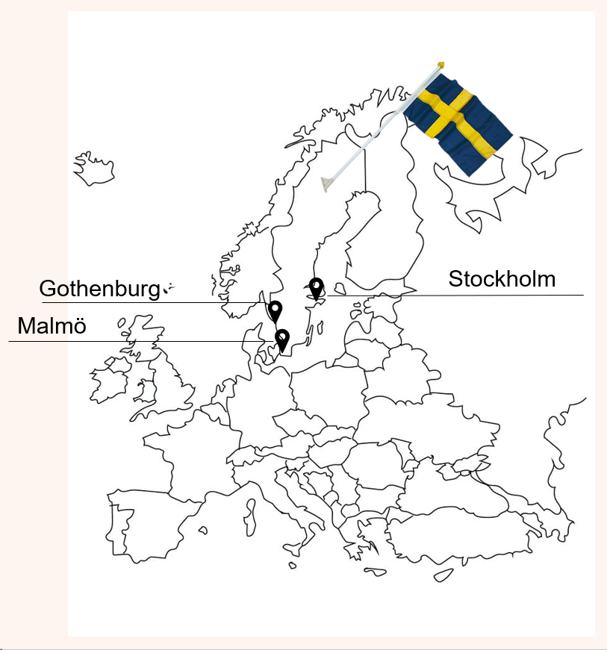
Sweden and its school system
10 years of compulsory school +
3 years in upper secondary/high school

Slide 3
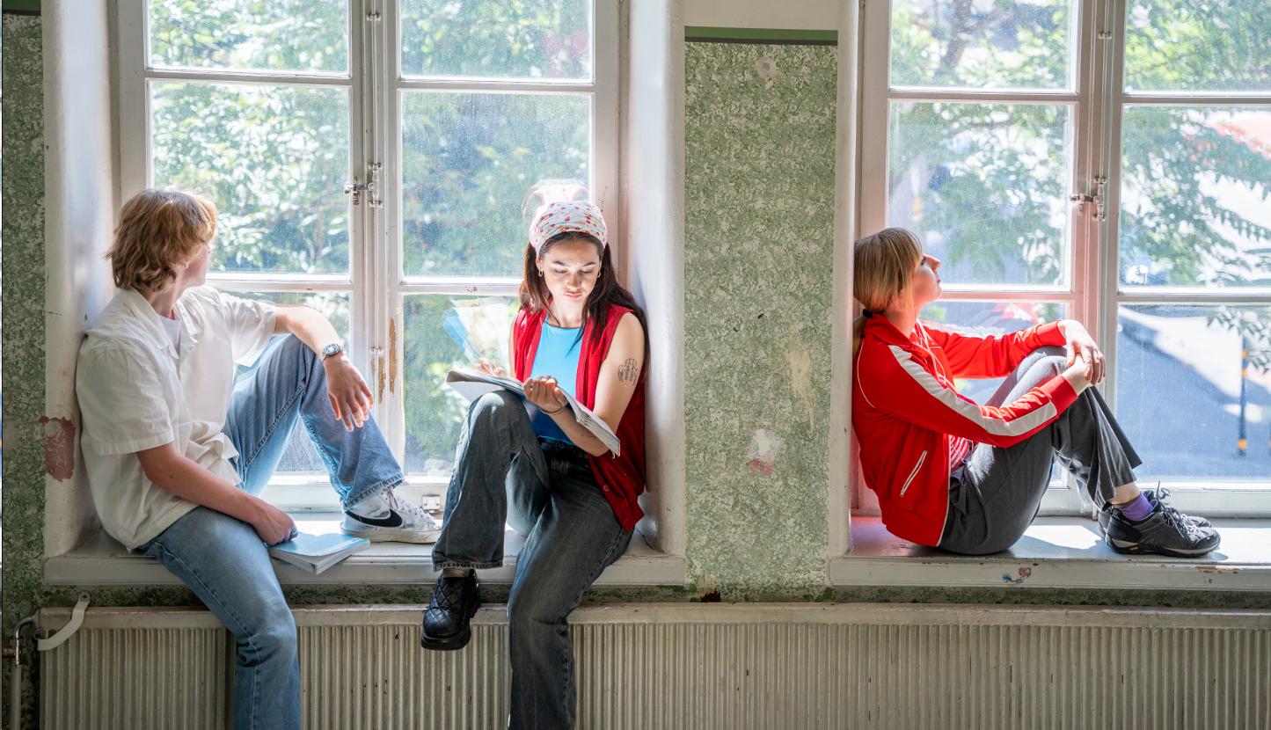
Braille education – from one special needs school to inclusive education
Less than 10 students in each grade read braille
A special needs school until 1987: Tomtebodaskolan
A shift in the view of disabilities → inclusive education in local schools for braille readers
Today:
– Inclusive education in mainstream school:
– Academic achievements at national level
– Less social participation (deVerdier, K. 2018)
A special needs school for MDVI students, but the majority attend mainstream schools

Slide 4
Today’s inclusive schools
Equal, adapted and avaliable education i braille and all school subjects
Support and professional learning from Resource Centre Vision
Advisors specialized in special needs training, visual impairment

Slide 5
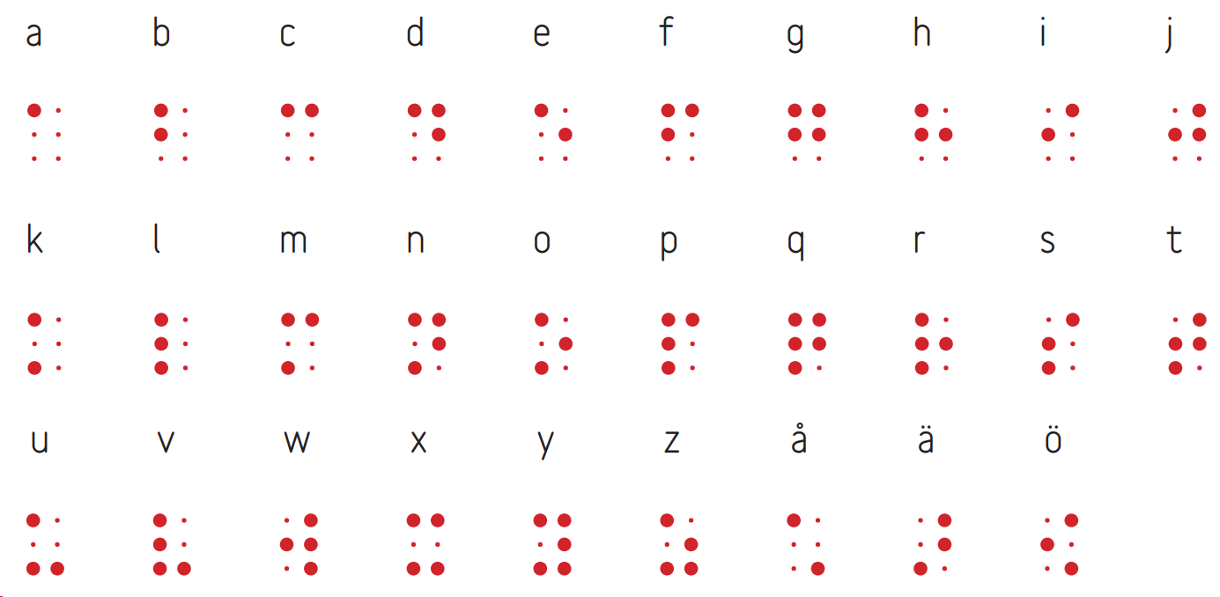
Braille in Sweden
Uncontracted braille
The time ascpect – graphemes and phonemes are relatively close in Swedish
Teaching braille and print together in mainstream schools
Teachers lack previous experience of braille

Slide 6
The role of English in Sweden

Slide 7
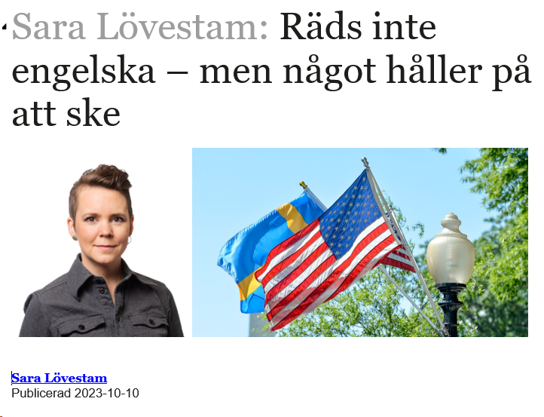
The role of English in Sweden
Daily exposure from television and streaming media
Subtitles in English
Anglicisms: outa, jinxa
Linguist Sara Lövestam:
” Don't be afraid of English - but something is happening“
English is more than just a school subject

Slide 8
Why study the use of English?
Blind students struggle more with English than sighted peers
English seems to be more difficult than other languages
Qualitative study: semi-structured interviews, thematic analysis (TA)
5 braille reading students in high school (17–19 years) ~ 30% of the entire group
4 English teacher

Slide 9
2 themes in students’ interviews
Lack of time – torn between short-term and long-term goals
English education based on a sighted norm

Slide 10
Lack of time – Braille reading replaced by listening
”Since you have to finish the assignments quickly, process information quickly, I tend to listen much more than before, not as much braille”
4 of 5 students do not read braille during English lessons
Language education in compulsory school was more traditional
No vocabulary homework

Slide 11
Braille reading replaced by listening
Ambivalent teachers:
" well, it is listening comprehension to a greater extent than reading comprehension. But in his case, it is a fine line … When he listens, it is still understanding of written text. It is written language in the ears.... So the text comprehension will be equivalent. But then again, he doesn't read with his fingers very often, he is far from the words, especially spelling, because spelling in English is not that easy."

Slide 12
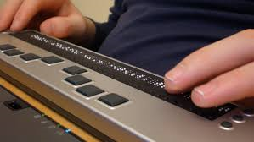
Tactile reading in specific situations
“sometimes when you write and want to know how to spell a word, braille is what I go to. It can help me sometimes to read in braille, just single words or a sentence, maybe a paragraph now and then, but otherwise, no"
Braille reading in Mathematics:
”You can't just listen to an equation, you have to read it with your fingers,
get it in text format".
"You kind of get a sense of the language. Those who listen and don't read,
I think they probably find spelling very difficult. That's probably why I read a lot".

Slide 13
Independently or with help from paraeducator?
Online work is difficult and/or time consuming
No time to practice
Meeting deadline is more important than independence
"Obviously I could do it myself, but sometimes you have to think, to what extent, I mean, how much time does it take to aim for total independence? Is it worth putting that much time into it?”
”Sometimes I play it safe. When I know the meaning of words but not the spelling,
I avoid using them in writing. My teacher has told me I’m holding back”

Slide 14
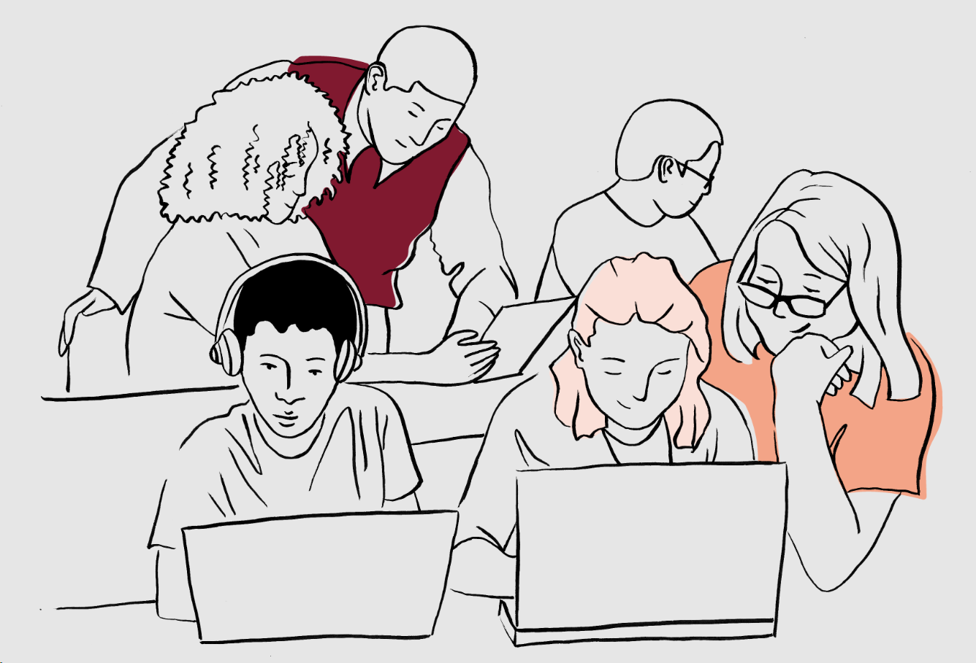
Teachers’ thoughts on independence and online work
"Apparently a lot is accessible on the internet“
"I haven't actually asked, but he has never indicated that he can't… It seems to be working“
No time in high school to improve digital strategies, keyboard shortcuts, braille…
Whose responsibility?

Slide 15
English education based on a sighted norm
Films not equal despite adaptations
” I didn’t know who was who, it was a bit confusing. The task didn’t go well, I didn’t pick up as much from the film as the others. I prefer working with novels for obvious reasons”
Use of direct quotes in literary analyses
”I guess sighted peers can just browse through the book to look for quotes.
Me, listening to an audiobook, it’s pretty difficult to find the right quotes to use”

Slide 16
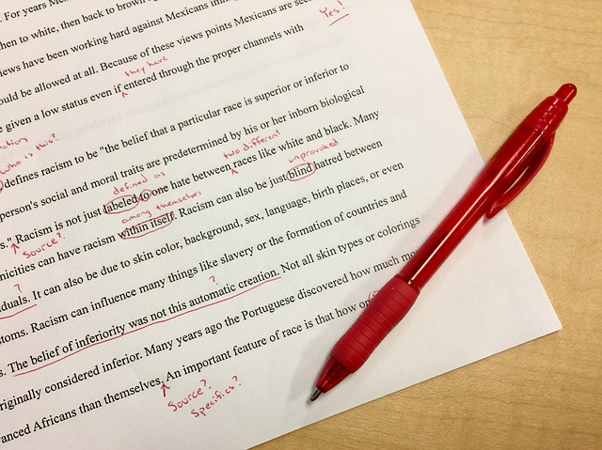
English education based on a sighted norm
Feedback from teachers – general, not specific textual comments
”I don’t know what kind of feedback my classmates receive, but comments on my text are mostly at a general level. That might be a bit negative, I don’t know, well, I’d say it is”

Slide 17
Second language acquisition in the US for VI students – similarities & differences?
Meeting deadlines rather than long-term goals / independence
– Reading → listening → spelling/writing difficulties
– Online work → paraeducator helps out → less extramural English
Nudging: keep prioritizing ICT skills and braille in high school
A sighted norm:
– film analyses
– quotations
– feedback

Slide 18
Extramural English – language learning through spare time activities
Pia Sundqvist (2009)
Extramural English Matters: Out-of-School English and Its Impact on
Swedish Ninth Graders' Oral Proficiency and Vocabulary
Prosumers = producers + consumers in co-creative activities
English a lingua franca in MMO games (Massively multiplayer online games )
Gaming improves vocabulary more than reading – active vs passive use of vocabulary

Slide 19
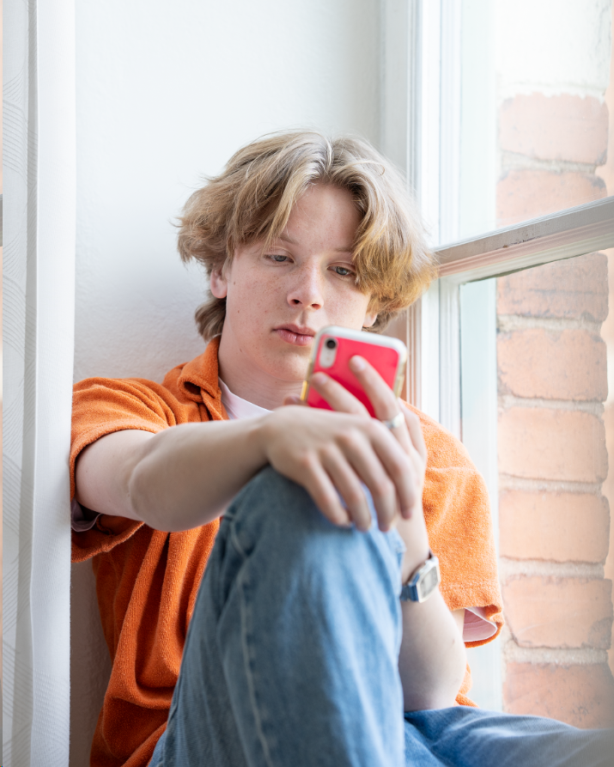
Blind students’ extramural English
Consumers of English
Wide range of activities – mainly auditory
”a lot of podcasts, facts, reading reviews of novels and games and stuff I’m interested in, check out some presentations or TED-talks on YouTube. Well, guess I’m a bit of a geek”

Slide 20
Inaccessible activities – online gaming
Awareness of limitations due to lack of vision
Online gaming– no social interaction:
“The online games I’ve played based on sound were single player, you don’t talk to anyone then. There is no community for players of audio-based games as with regular games. It’s quite limited”
Focus on one’s own shortcomings, not inaccessibility:
"I don't really know, maybe I haven't had the opportunity or I haven’t felt motivated or I just feel insecure about it"

Slide 21
Inaccessible activities – social media
Social media partially accessible, but requires good ICT skills
Memes – combination of text and visual information
”There’s a lot of focus on visual images and pictures and now when TikTok is so popular, people use it, they use it differently than I do”
The social aspect matters the most
Captions enables learning for sighted students

Slide 22
Inaccessible activities – series and films
Few series with audio descriptions
They miss out on the social aspect of series and movies
Visual information enables young learners to take on more difficult tasks
"Many of my friends were watching English movies from an earlier age than me. I started watching English films and YouTube when I was about 15, while others had been doing that since they were like 7”
”In Spanish I was one of the best because none of us knew anything beforehand. There were no series in Spanish that the others watched that could mess things up. All of us were on the same page"

Slide 23
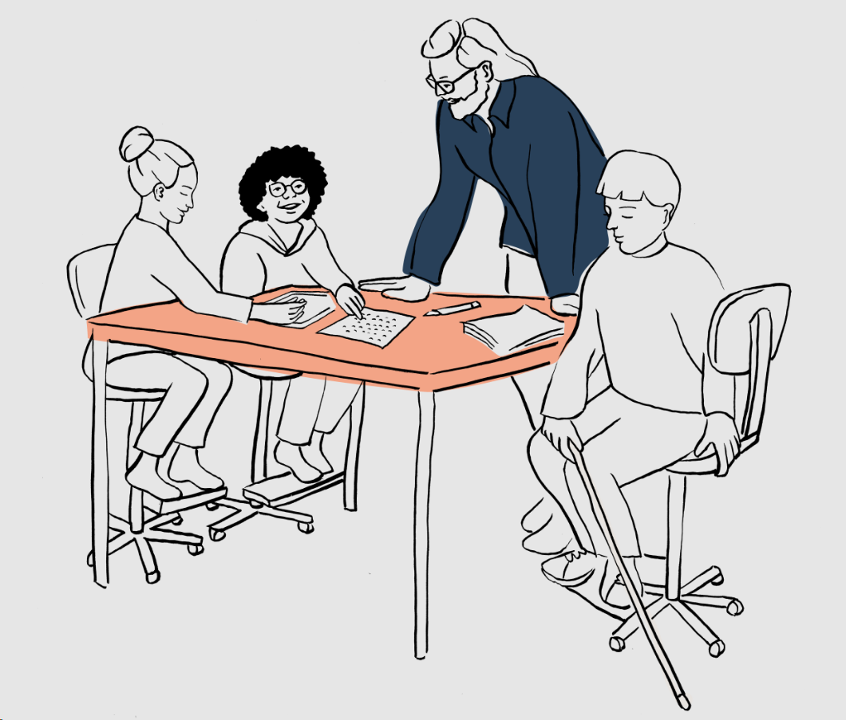
Results in English vs other language studies
English language / American culture – a huge influence on Swedish teenagers
Annika Risberg (2020): Braille reading students’ final marks in 9th grade compared to the national average for the last 20 years
– at national average in 10 of 12 theoretical subject
– below in English
– above in modern languages: Spanish, German or french

Slide 24
Extramural English – accessible activities
Literature - mostly audiobooks
”I’m more of a book-type kind of person”
Auditory information online
”Verbal” YouTubers, TED-talks, documentaries

Slide 25
Implications
Keep encouraging braille reading
Sweden also needs an Expanded Core Curriculum
ICT skills are important, for school and extramural learning
Fun accessible activities to improve English?

Slide 26
Thank you for listening!
Carina Söderberg
Swedish National Agency for Special Needs Education and Schools
Stockholm, Sweden
carina.soderberg@spsm.se

Slide 27
References
de Verdier, K. (2018). Children with blindness: Developmental aspects, comorbidity and implications for education and support. Diss. Stockholm University, Sverige. https://www.diva-portal.org/smash/get/diva2:1206093/FULLTEXT01.pdf
Risberg, A. (2020). (Written in Swedish) " Måluppfyllelse för punktskriftsläsande elever i grundskolan” (=Braille reading students grades in compulsory school) https://www.spsm.se/contentassets/956abc84f24448949ed84139694b3953/examensarbete-annika-risberg.pdf
Sundqvist, Pia (2009). Extramural English Matters: Out-of-School English and Its Impact on Swedish Ninth Graders' Oral Proficiency and Vocabulary. Diss. Karlstad University. https://kau.diva-portal.org/smash/get/diva2:275141/FULLTEXT03.pdf

